Slide 1
Presentation of Application of ICT
By: 4 future Tech
To: Prof. Yawar Sb

Slide 2

Task # 1
Create a Research Paper on MS Word

Slide 3
TABLE OF CONTENTS
01
Introduction
07
Adding a Table
02
Create New Document
08
Changing Page Orientation
03
Save Document
09
Adding Header and Footer
04
Formatting Text
10
Adding Page Numbers
05
11
Spell Check and Grammar Check
Find & Replace
06
Adding a picture
12
Conclusion

Slide 4
Introduction:
Microsoft Word is a word processing software used to create, edit, format, and print documents. It is commonly used for writing letters, assignments, reports, and projects. In this documentation, we explain which task is performed using which option in Microsoft Word, along with visual examples.

Slide 5
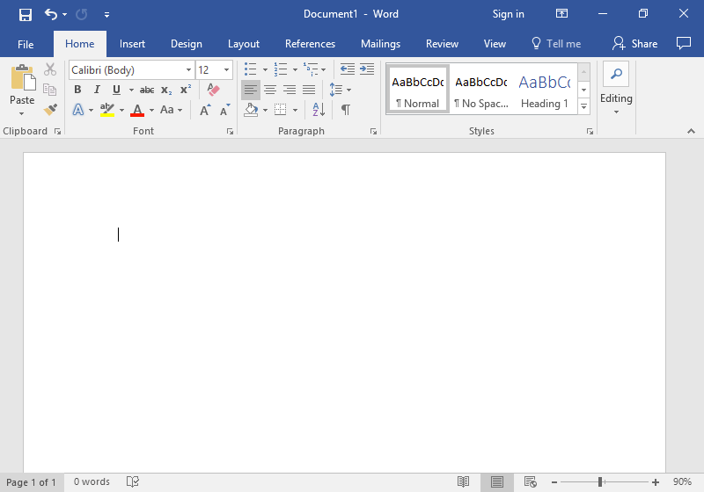
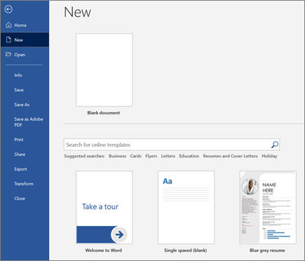
Creating a New Document:
Operation Performed: Create a new blank document
Option Used:File → New → Blank Document
Explanation:To start working in MS Word, we first create a new document. This gives us a blank page where we can write our content.

Slide 6
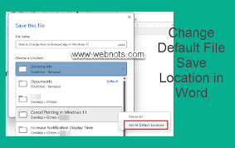
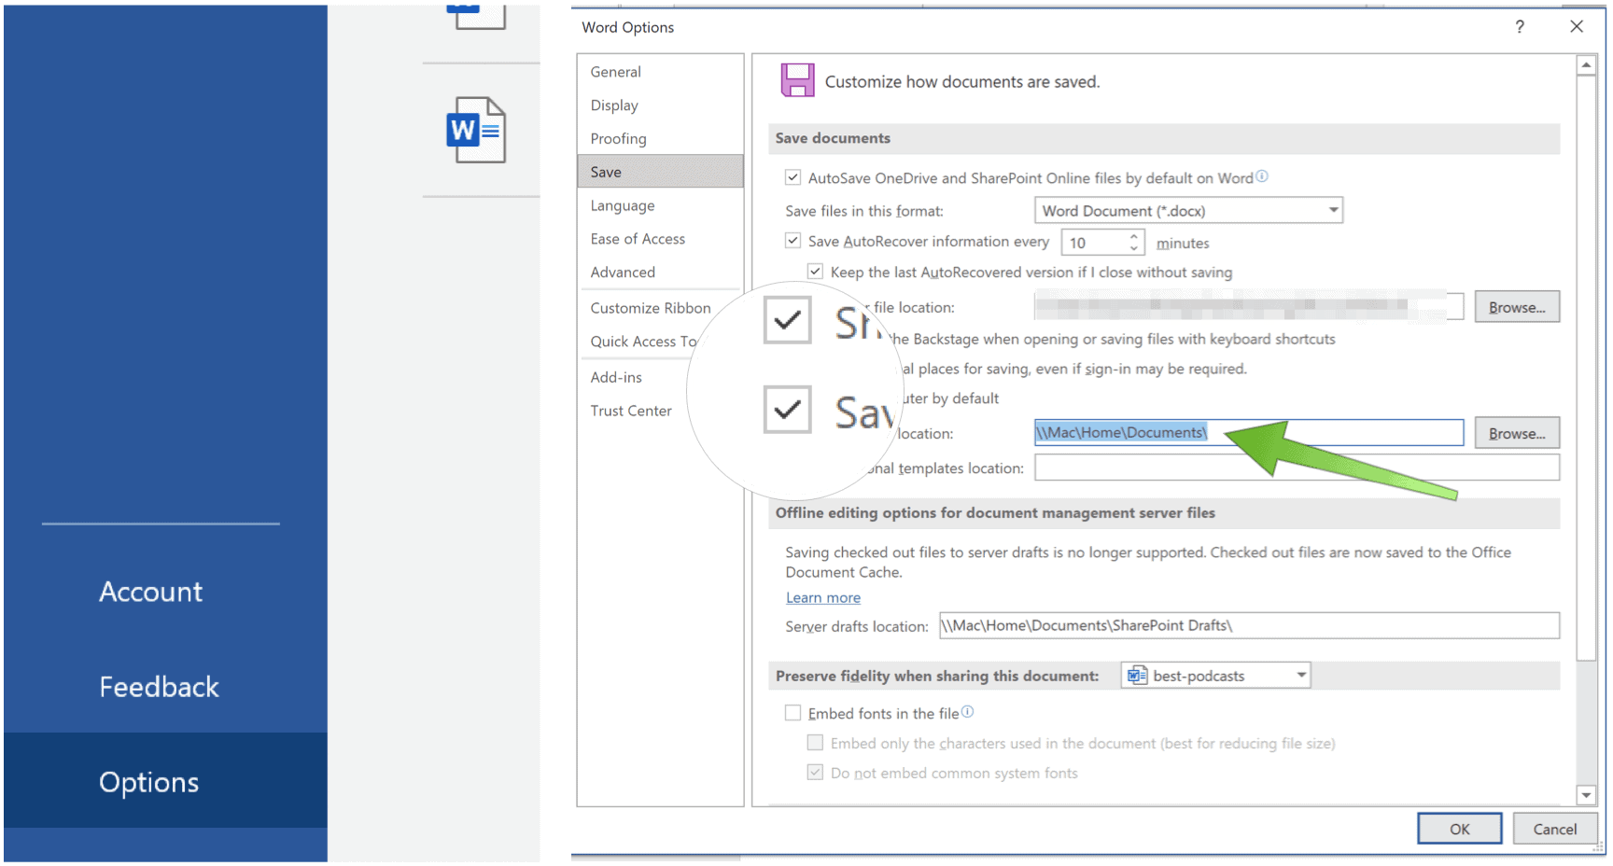
Saving the Document:
Operation Performed: Save the document
Option Used: File → Save As → Choose Location → File Name → Save
Explanation: After writing content, we save the file so our work is not lost. We choose the location and give a file name.

Slide 7
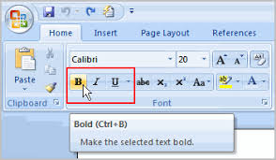
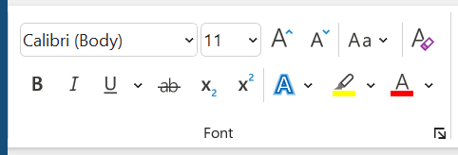
Formatting Text (Bold, Italic, Underline):
Operation Performed: Change text style
Option Used: Home Tab → Font Group → Bold (B), Italic (I), Underline (U)
Explanation: These options are used to make text dark (bold), slanted (italic), or underlined.

Slide 8
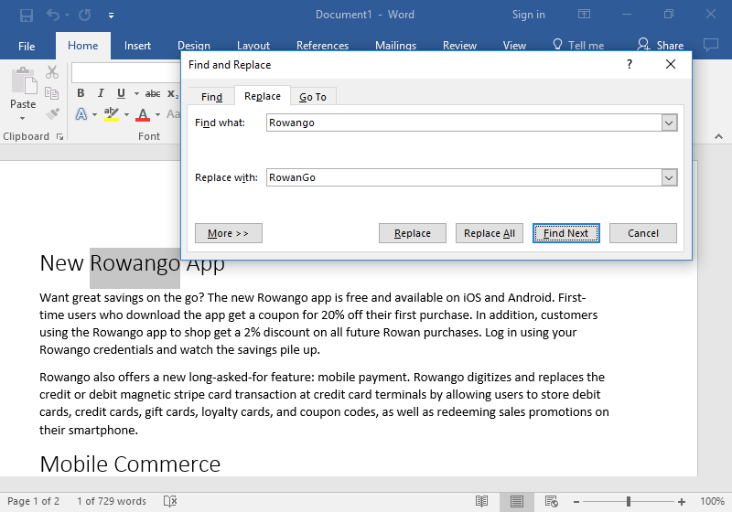
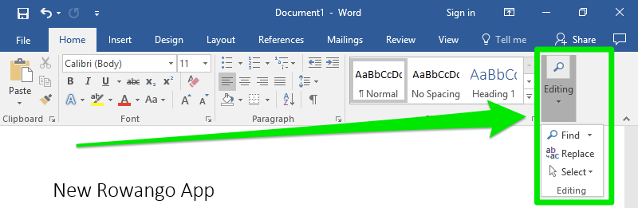
Find & Replace:
Operation Performed: Replace words in the document
Option Used: Home Tab → Editing Group → Replace
Explanation: The Replace feature is used to quickly change a word or sentence throughout the entire document.

Slide 9
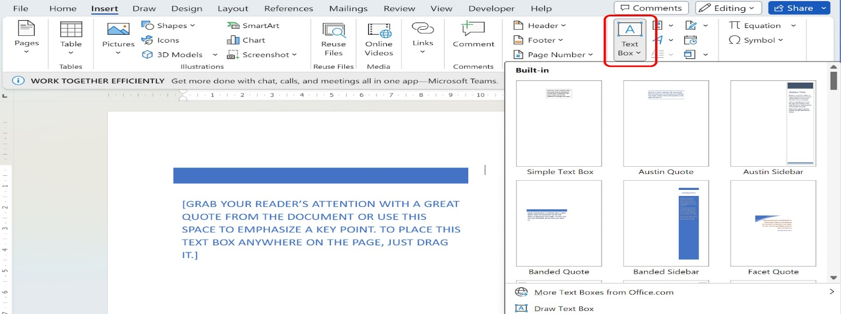
Adding a text box:
Operation Performed: Adding a text box
Option Used: Insert Tab → Text Box → Simple Text Box
Explanation: Explanation: A text box allows us to write text anywhere on the page separately from the main text. It is mostly used for writing short notes, headings, or important information on the side of the page.

Slide 10
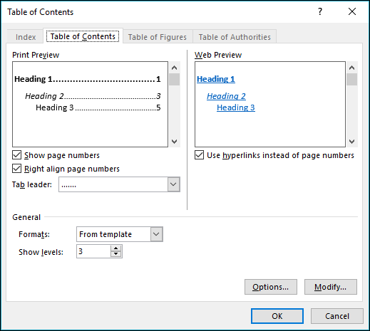
Table of Content:
Operation Performed: Create a table of contents
Option Used: References Tab → Table of Contents → Select Style
Explanation: Explanation: A table of contents automatically shows headings with their page numbers. It helps readers quickly find topics in long documents

Slide 11
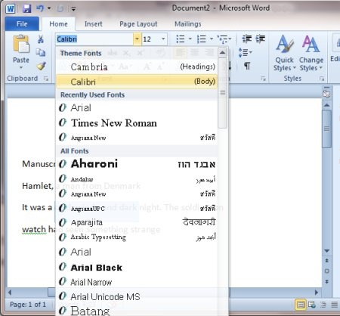
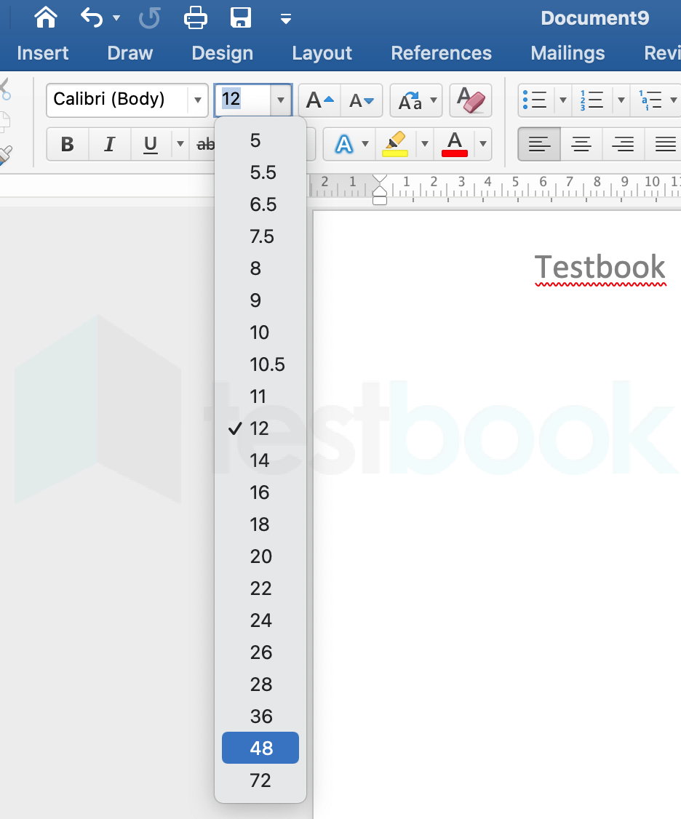
Changing Font Size and Style:
Operation Performed: Change font size and font type
Option Used: Home Tab → Font Group → Font Style & Font Size Box
Explanation: We use this option to change the appearance of text such as Times New Roman, Arial, and the size like 12, 14, 16, etc

Slide 12
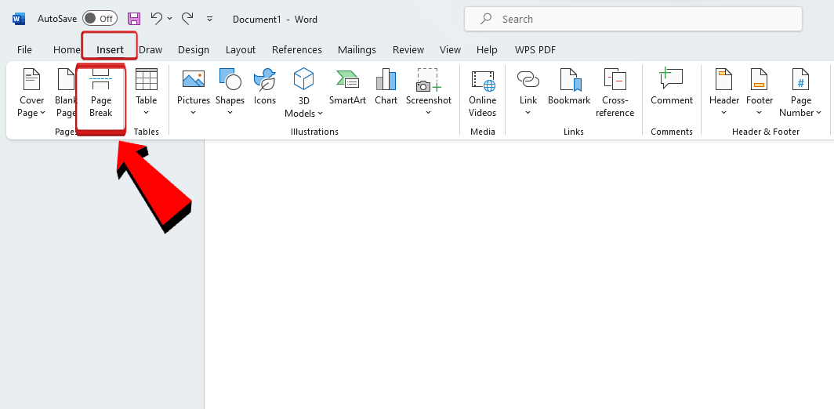
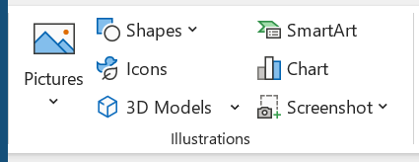
Adding a Picture:
Operation Performed: Insert an image
Option Used: Insert Tab → Pictures → This Device → Select Image → Insert
Explanation: This option is used to add pictures into the document for better presentation.

Slide 13
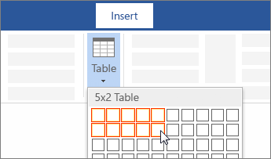
Adding a Table:
Operation Performed: Insert a table
Option Used: Home Insert Tab → Table → Select Rows and Columns
Explanation: Tables are used to organize data in rows and columns.

Slide 14
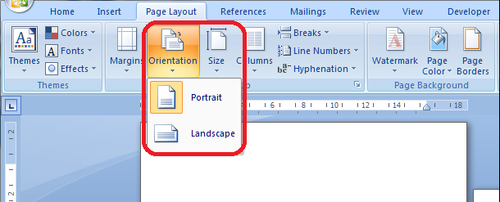
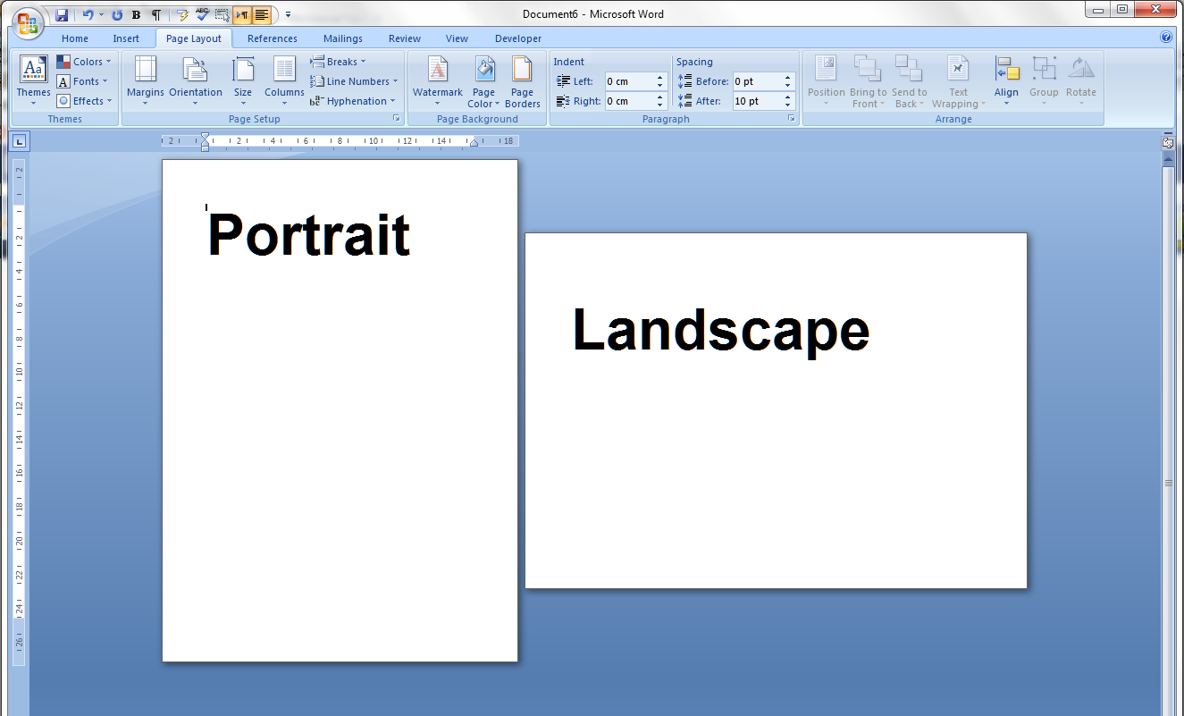
Changing Page Orientation:
Operation Performed: Change page layout
Option Used: Layout Tab → Orientation → Portrait / Landscape
Explanation: This option is used to change the page direction.

Slide 15
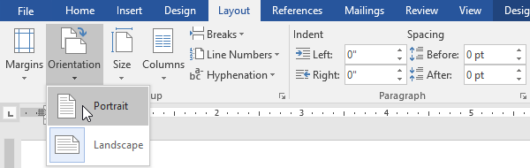
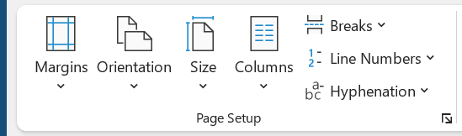
Setting Page Margins:
Operation Performed: Set page margins
Option Used: Layout Tab → Margins → Choose Margin Size
Explanation: Margins control the empty space around the page.

Slide 16
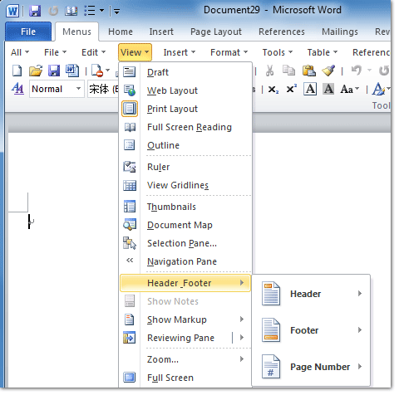
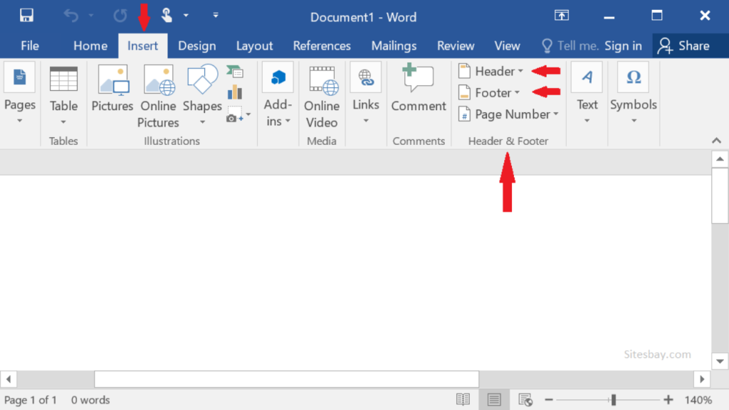
Adding Header and Footer:
Operation Performed: Add header and footer
Option Used: Insert Tab → Header / Footer
Explanation: Headers and footers are used to show titles, page numbers, and dates.

Slide 17
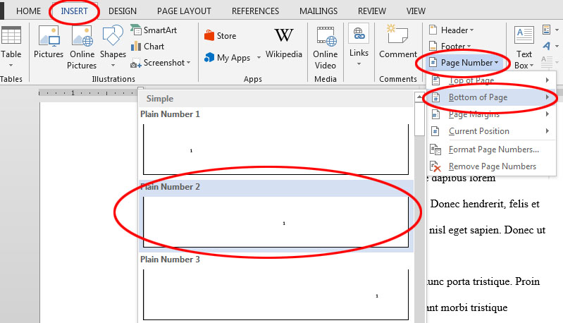
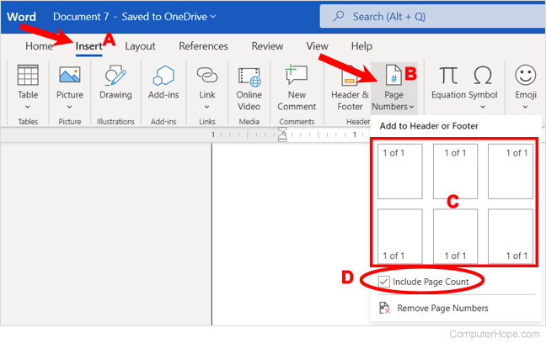
Adding Page Numbers:
Operation Performed: Add page numbers
Option Used: Insert Tab → Page Number → Select Position
Explanation: Page numbers help to organize long documents.

Slide 18
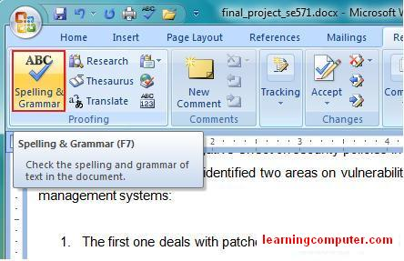
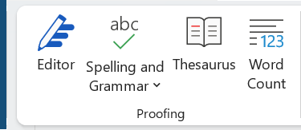
Spell Check and Grammar Checker:
Operation Performed: Check spelling and grammar
Option Used: Review Tab → Spelling & Grammar
Explanation: Page numbers help to organize long documents.

Slide 19
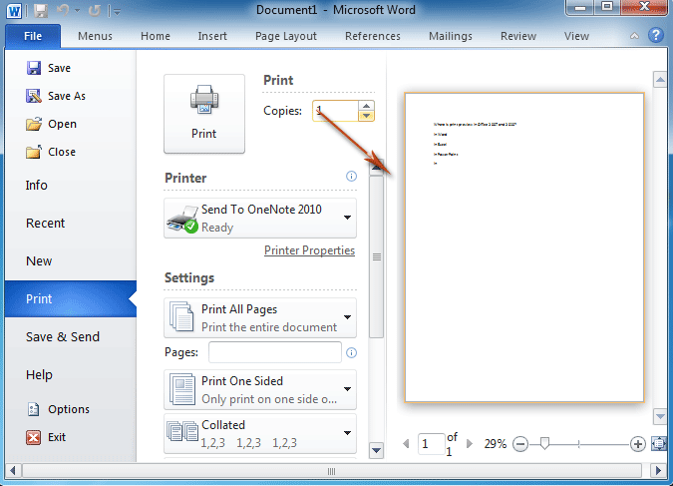
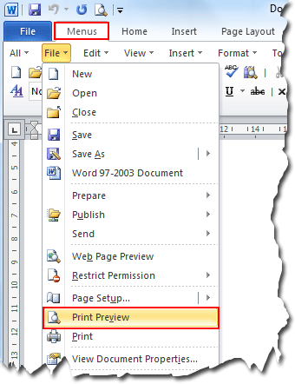
Printing the Document:
Operation Performed: Print the document
Option Used: Insert Tab → File → Print → Select Printer → Print
Explanation: This option is used to take a hard copy of the document.

Slide 20

CONCLUSIONS
Microsoft Word is an easy and powerful software for creating documents. In this documentation, we explain each operation and the exact menu/option used, such as inserting pictures from the Insert menu, formatting text on the Home tab, and printing from the File menu. These tools help users prepare professional documents easily.

Slide 21
Task # 2
Create an Inventory Management System using MS Excel

Slide 22
Tabel of content:
Contents
STOCK CONTROL SHEET FOR RETAIL SHOP
Abstract
Introduction
Purpose of the Project
Data Fields in the Sheet
SUM formula used
Sales Value Formula (recommended but missing)
Conclusion
Summary

Slide 23
Stock Control Sheet:
Abstract:
This project is a Stock Control Sheet designed in Microsoft Excel for managing a retail shop’s inventory. It helps track unit price, quantity in hand, quantity sold, inventory value, and sales value. The sheet uses basic Excel formulas to calculate totals and automatically update stock-related information. This project demonstrates the practical use of Excel functions for business management and inventory tracking.

Slide 24
Introduction:
Inventory management is essential for retail businesses. Keeping track of stock levels, sales, and product values manually can be difficult and time-consuming. This Excel-based Stock Control Sheet provides a simple and efficient way to monitor:
Available stock
Items sold
Inventory value
Sales value

Slide 25
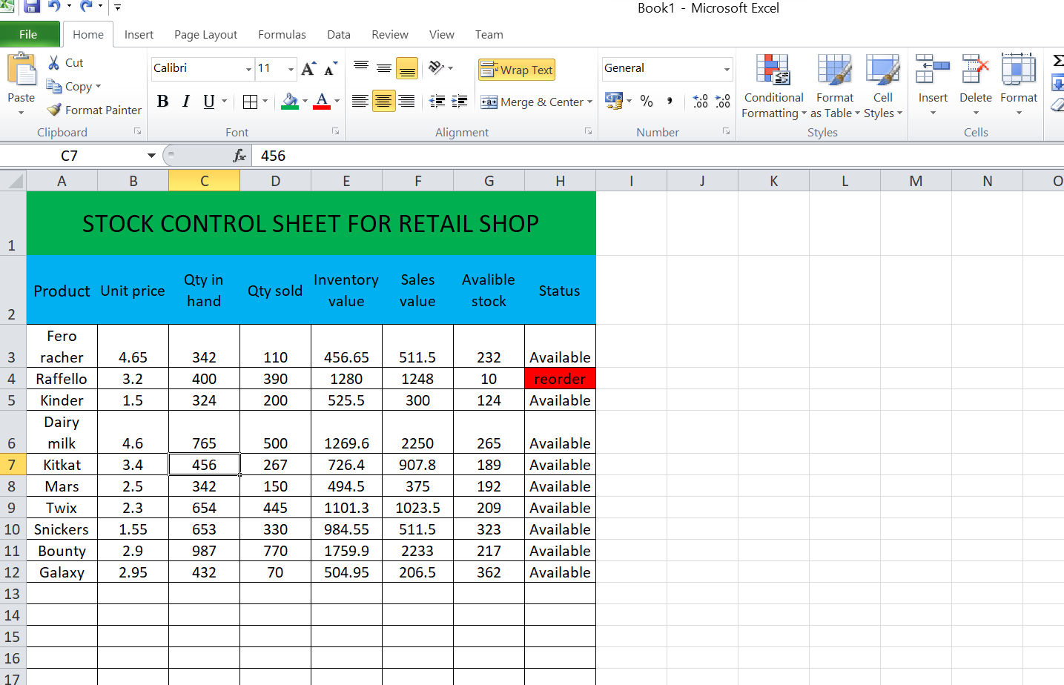
All practical work :

Slide 26
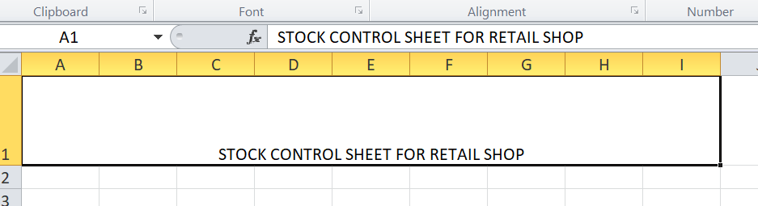
Step 1:

Slide 27
Step 2:

Slide 28
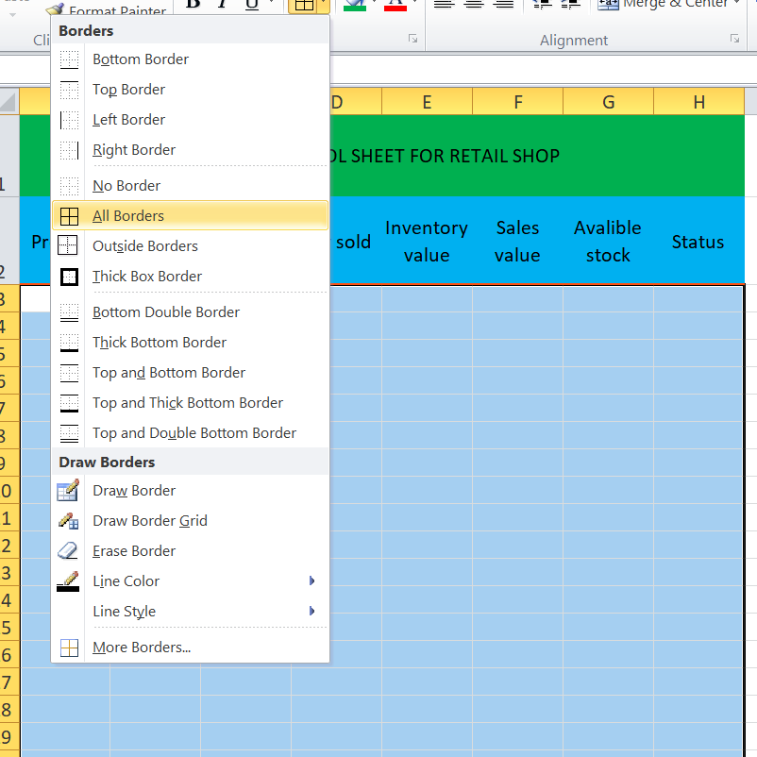
Step 3:

Slide 29
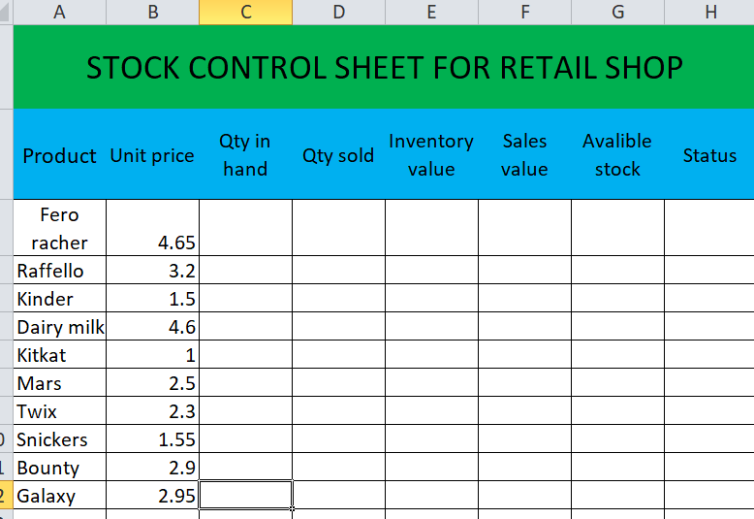
Step 4:

Slide 30
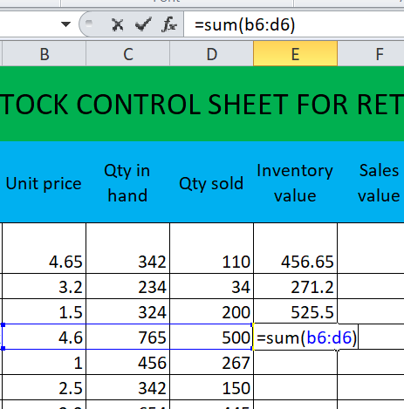
Step 5:

Slide 31
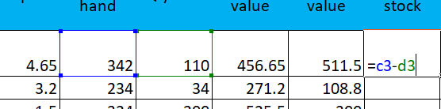
Step 6:

Slide 32
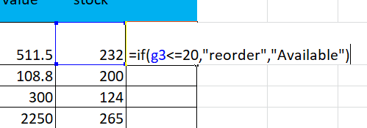
Step 7:

Slide 33
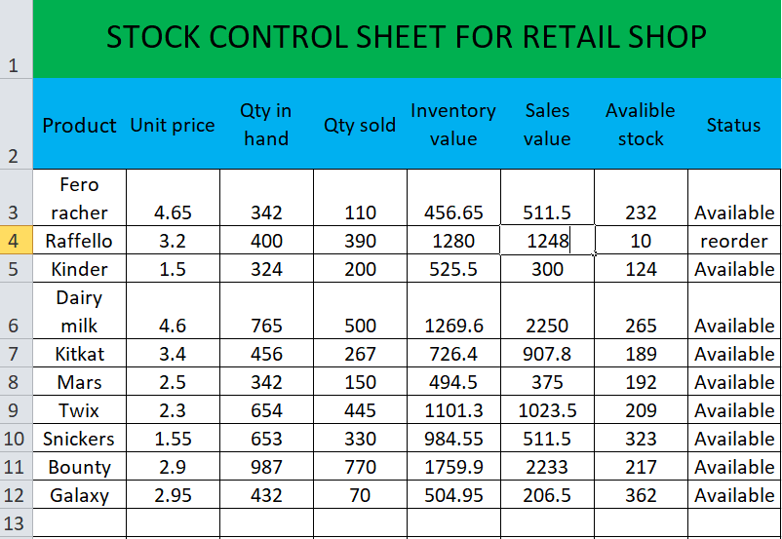
Step 8:

Slide 34
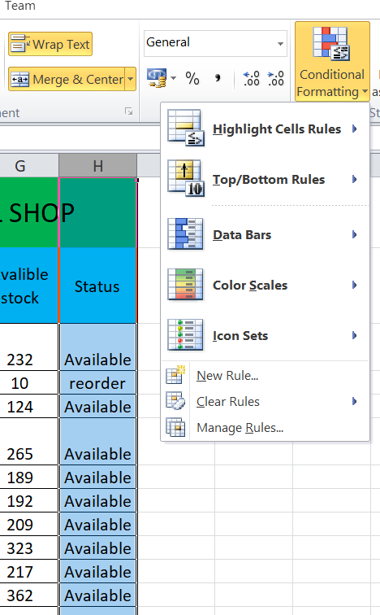
Step 9:

Slide 35
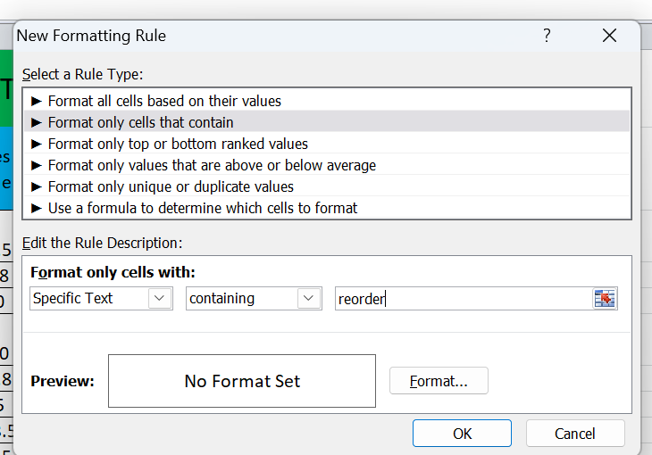
Step 10:

Slide 36
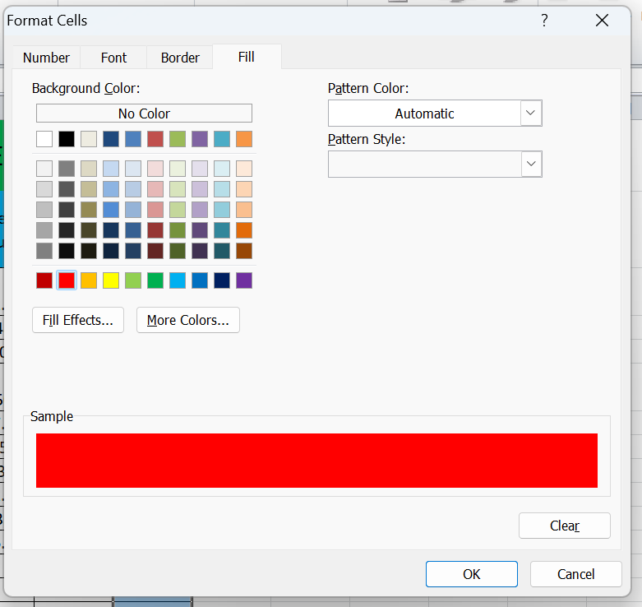
Step 11:

Slide 37
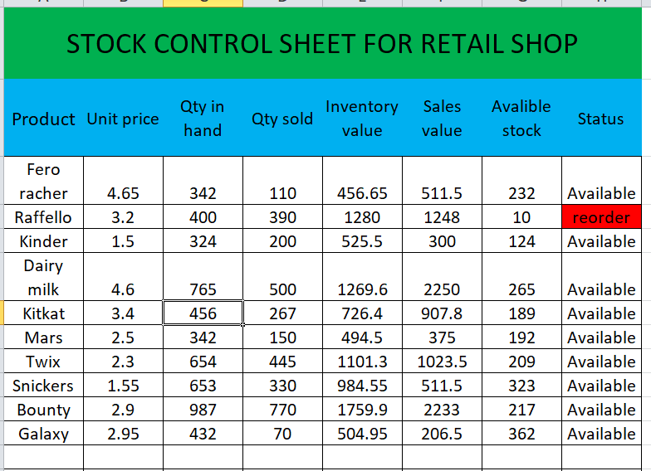
Step 12:

Slide 38
Step 13:

Slide 39
Purpose of this task:
The purpose of this Task is:
To maintain accurate stock records
To calculate sales and inventory values using formulas
To make inventory tracking easy for retail shop owners
To provide a user-friendly Excel sheet for business management
Data Fields in the Sheet:
Unit Price
Qty in Hand (Quantity available)
Qty Sold
Inventory Value
Sales Value

Slide 40
Formula:
SUM formula used:
You used:
=SUM(B6:D6)
Sales Value Formula (recommended but missing)
(Unit Price × Qty Sold)

Slide 41
Conclusion:
This project demonstrates how Microsoft Excel can be used for efficient retail inventory management. Using simple formulas, the sheet automates calculations that help reduce errors and save time. Though the core functionality is complete, it can be improved by adding more formulas, totals, and conditional formatting for a more professional and advanced system.

Slide 42
Summary:
This project is a Stock Control Sheet designed in Microsoft Excel to help manage inventory for a retail shop. It keeps track of essential product information such as unit price, quantity in hand, quantity sold, inventory value, and sales value. The sheet uses Excel formulas—such as multiplication and SUM—to automatically calculate values, making the work faster and more accurate. By organizing stock data into a structured table, the sheet helps monitor available stock, determine product value, and understand sales performance. Overall, this project provides an efficient, simple, and reliable way to manage retail inventory using Excel.

Slide 43
Thanks!
Do you have any questions?

Slide 44
Task # 3
Create an Inventory Management System using HTML & CSS

Slide 45
Introduction:
Project Goal: The main objective was to develop the front-end data entry component for an Inventory Management System (IMS) that is both functional and provides a superior user experience (UX). The form’s success is measured by its usability and aesthetic design, which promote accurate and efficient data recording, a critical factor for operational efficiency.

Slide 46

Figure:

Slide 47
Basics HTML Tags
Explanation:
<!DOCTYPE html> → Tells the browser this is an HTML5 document
<html> → Root element of the page
<head> → Contains page info (title, CSS, etc.)
<title> → Page title (shown on browser tab)
<body> → Visible content of page

Slide 48
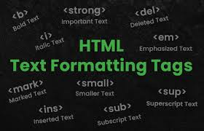
Formatting Text:
<h1> to <h6> → Headings
<p> → Paragraph
<br> → Break line
<hr> → Horizontal line
<b> → Bold
<i> → Italic
<u> → Underline
<strong> → Important text
<mark> → Marked text

Slide 49
Link & image:
For put link:
<a href="https://google.com">Visit Google</a>
For Image :
<img src="image.jpg" alt="My Image">

Slide 50
List:
Ordered List:
<ol>
<li>HTML</li>
<li>CSS</li>
<li>JavaScript</li>
</ol>
Unordered List :
<ul>
<li>Apple</li>
<li>Mango</li>
</ul>

Slide 51
Tables:
<table border="1">
<tr>
<th>Name</th>
<th>Age</th>
</tr>
<tr>
<td>Ali</td>
<td>20</td>
</tr>
</table>

Slide 52
Forms & Input Tags:
<form>
<label for="name">Name:</label><br>
<input type="text" id="name" placeholder="Enter your name"><br><br>
<label for="email">Email:</label><br>
<input type="email" id="email" placeholder="Enter your email"><br><br>
<label for="password">Password:</label><br>
<input type="password" id="password" placeholder="Enter your password"><br><br>
<label for="male">Male</label>
<input type="radio" value="Male">
<label for="female">feMale</label>
<input type="radio" value="Female">
</form>

Slide 53
Div & Span:
<div> → Block container
<span> → Inline container
Example:
<div>This is a box</div>
<span>This is inline</span>

Slide 54
CSS Syntax:
selector {
property: value;
}
Explain:
selector → which HTML element you want to style
property → what you want to change (color, size, etc.)
value → the setting for that property

Slide 55
CSS Syntax:
Color → Text color
background-color → Background color
Font-size → Text Size
Font-family → Text font
Text-align → Align text (left, right& center)
Margin → Space outside element
Padding → space inside element
Border → border style
Width → width of element
Height → height of element
Display → block, flex, etc.
Position → Static, fixed, etc.

Slide 56
Conclusion:
This project successfully implemented a core business function—inventory data entry—by applying modern web development practices to ensure superior UX, visual consistency, and a foundation for system scalability. The design choices were deliberate in making the data capture process efficient and engaging.

Slide 57
Thanks!
Do you have any questions?

Slide 58

What is PowerPoint ?

Slide 59
PowerPoint:
PowerPoint is a presentation software developed by Microsoft that is used to create multimedia slideshows with text, images, and videos. It is a popular tool in both business and education for creating engaging presentations that can be shared online or offline, and it includes features like animations, transitions, and collaboration tools.

Slide 60
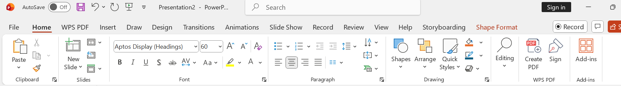
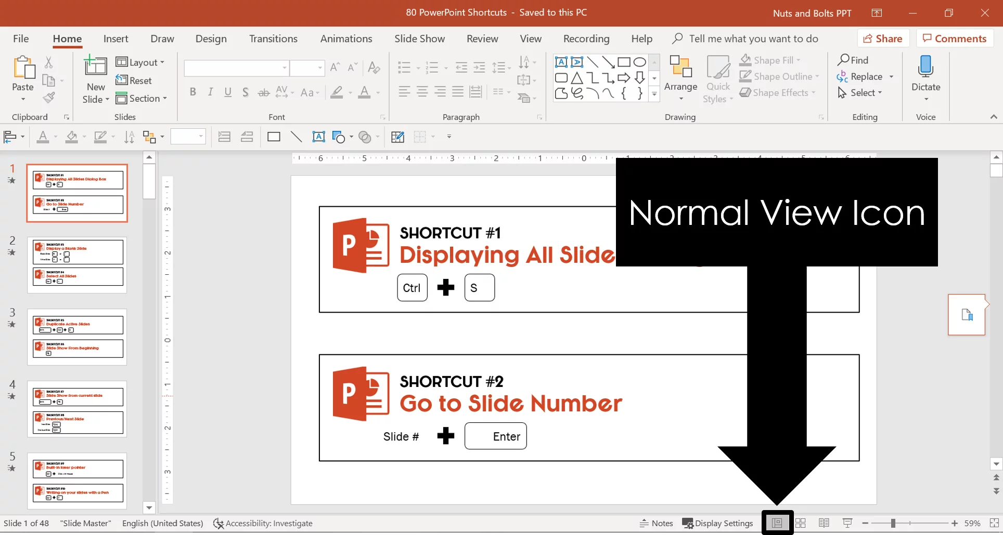
The User Interface and Navigation
The Ribbon:
This centralized command center organizes tools into logical tabs (Home, Insert, Design, Animations, Slide Show, etc.).
Slide Pane and Outline View:
Users manage the flow of the presentation through the Slide Pane, which displays thumbnails of all slides. The Outline View allows for focused text editing and restructuring of content without visual distractions.

Slide 61
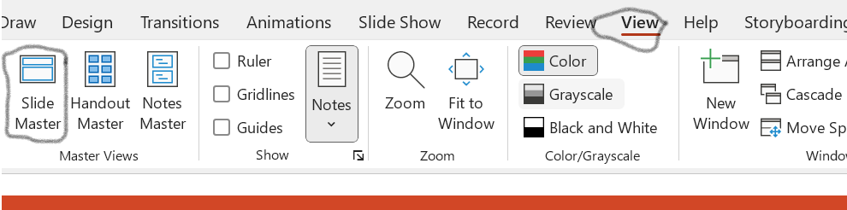
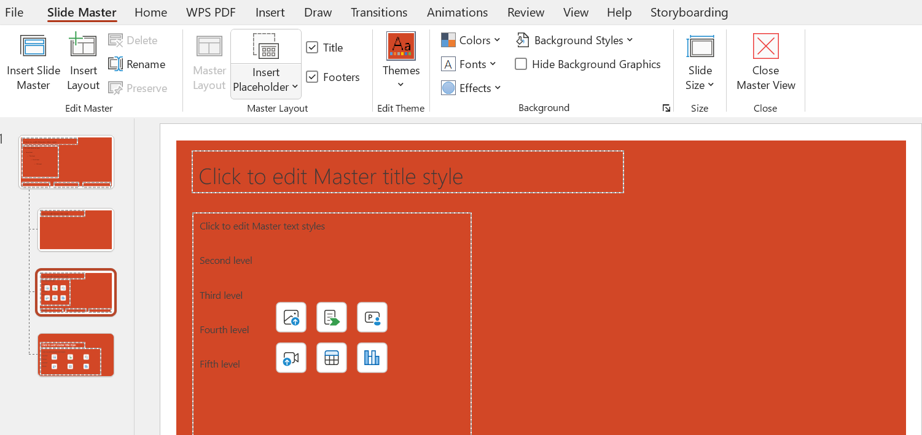
Slide Management and Design Consistency:
Slide Master:
By editing the master, a single change is propagated across all slides, ensuring a uniform, professional appearance.
Steps:
Go to the View Tab and click the Slide Master button.
Select the largest top slide in the left-hand pane to apply global changes.
Make necessary modifications (e.g., inserting a corporate logo or setting the title font).
Return to the dedicated Slide Master Tab and click Close Master View.

Slide 62
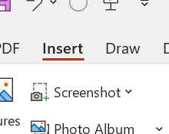
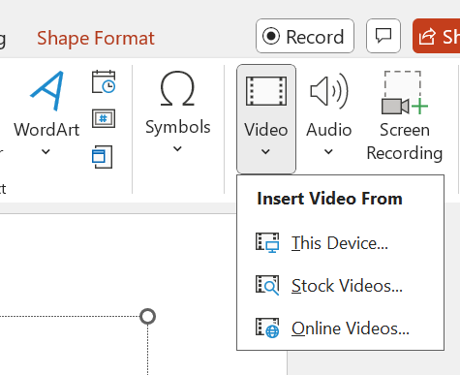
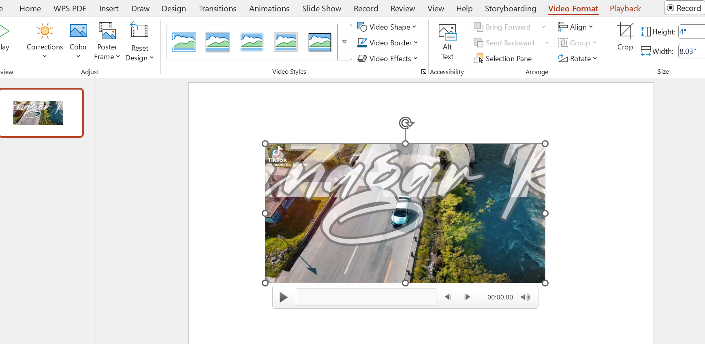
Multimedia Integration and Data Visualization
Media Embedding:
High-quality presentation demands dynamic media. PowerPoint allows for the seamless embedding of Video
Steps :
Insert the video file via the Insert Tab.
With the video selected, go to the context-sensitive Playback Tab.
Set the video to start automatically or On Click as required.

Slide 63
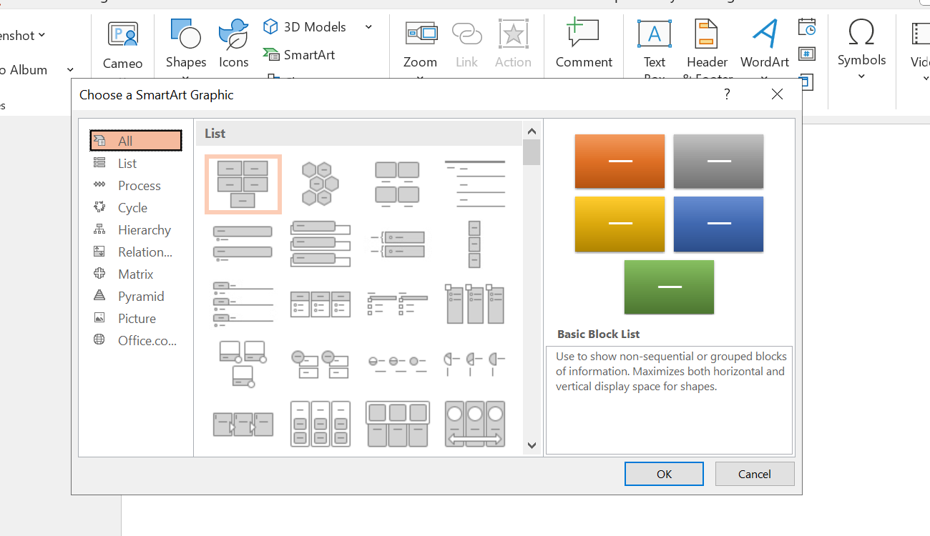
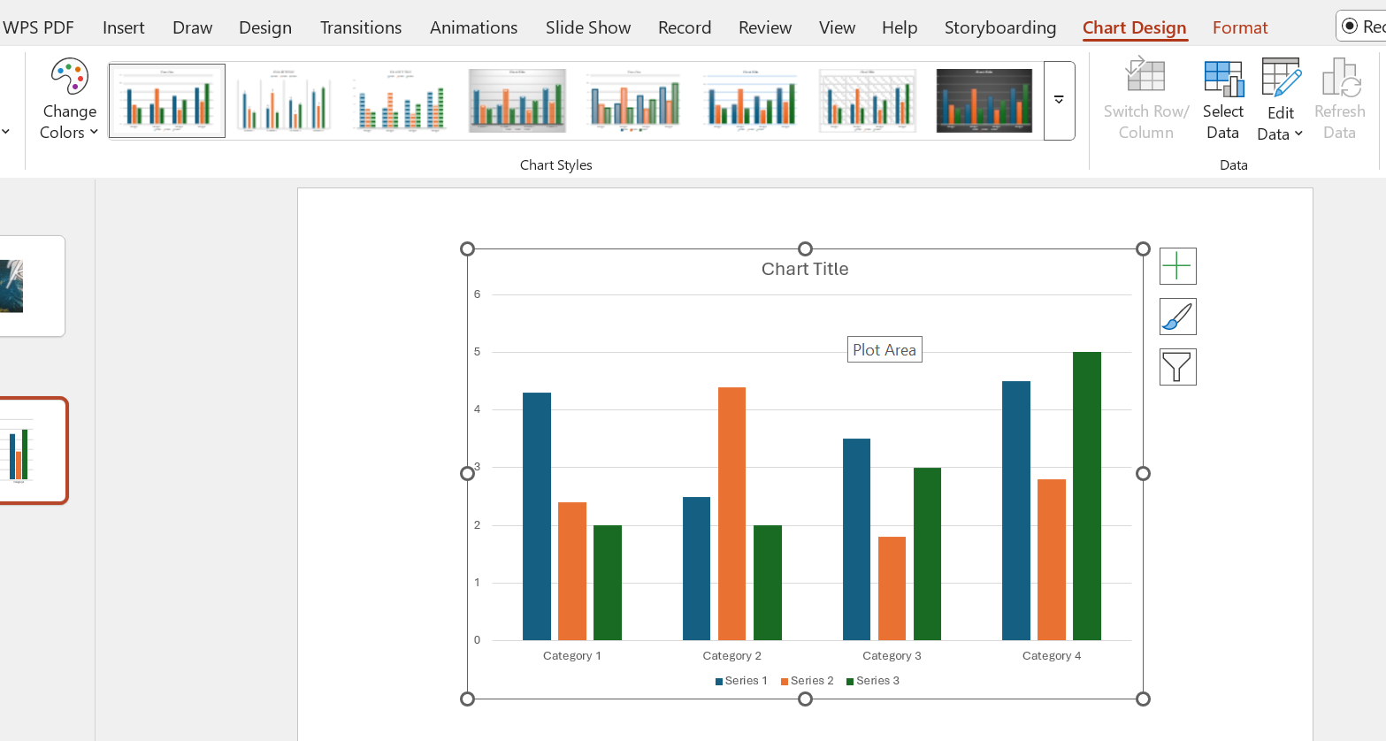
Charts and Graphs
SmartArt, charts, and Graphics: This feature enables the rapid creation of complex informational graphics, such as organizational charts, process flows, timelines, and relationship diagrams, using structured, professional layouts.
Steps (Inserting and Linking a Chart and Graph):
Go to the Insert Tab and click Chart.
Select the desired graph type
Replace the sample data in the automatically opened, linked Excel sheet with the project's data; the chart updates in real-time.

Slide 64
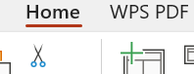



Visuals Data
Themes, SmartArt, and Movement
Visual appeal and logical structure are enhanced through specialized design tools. Themes (in the Design Tab) provide instant, pre-packaged aesthetic upgrades. SmartArt Graphics allow users to convert simple text into professional, schematic diagrams
Steps (Converting Text to SmartArt):
Select the text box containing the bulleted list.
On the Home Tab, click the Convert to SmartArt Graphic button.
Choose the visual layout that best represents the relationship

Slide 65





Animation effect:
These tools control the timing and movement of content, guiding the audience's focus:
Animations: Applied to individual objects (text boxes, images, charts), animations control their entrance, emphasis, or exit. Careful use of animations can highlight key data points or reveal bullet points sequentially ("building" content), preventing information overload.

Slide 66



Transition:
These are visual effects applied between slides, managing the shift from one idea to the next. They should be used sparingly and consistently to avoid distraction, typically favoring subtle effects like Fade or Push.
Steps:
From the transition tab, select any transition.
Select the rotate transition from the dynamic transition when you click on the drop-down menu of transitions

Slide 67


Presenter Tools for Confident Delivery
Effective presentation delivery relies on separating the audience's view from the speaker's private controls. The Notes Pane allows the speaker to write Speaker Notes, which are visible only when utilizing Presenter View. This vital feature provides the presenter with a private dashboard showing the current slide, the next slide, the essential notes, and a running clock, ensuring a smooth and well-timed delivery. The Rehearse Timings tool further aids professionalism by recording the time spent on each slide, optimizing pacing.
Steps:
Add detailed talking points to the Notes Pane beneath the slide.
Go to the Slide Show Tab and ensure the Use Presenter View checkbox is selected.
Start the presentation (F5); the presenter view will launch on the secondary screen.
Notes:
This is note pane my prsentator tool

Slide 68



Delivery and Collaboration Tools
Modern PowerPoint extends its utility beyond creation to include presentation delivery and teamwork:
Presenter View: This dedicated mode is vital for speakers. It displays the current slide, the next slide, and the all-important Speaker Notes on the presenter's screen, while only the main slide is shown to the audience.
Rehearse Timings: This feature allows the presenter to practice their talk and record the time spent on each slide, optimizing pacing for delivery.
Co-authoring and Cloud Integration: With integration into Microsoft 365 and OneDrive, multiple users can edit the same presentation simultaneously, facilitating real-time collaboration among geographically dispersed teams.

Slide 69


Record feature:
PowerPoint's record feature lets you capture your presentation with narration (audio/video), ink gestures, and timings, turning static slides into dynamic, personal videos for sharing or e-learning, offering tools like a teleprompter, annotations (laser, pens), background blur, and easy export to MP4, allowing for professional, engaging content creation without needing separate video software.
Steps:
In the record, select from the beginning for recording .
Set the time according to your needs and requirements.

Slide 70
Any query?

